Slide 1


AN INTRODUCTION TO PROGRAMMING
BY ANTÓNIO fERNANDES

Slide 2
TABLE OF CONTENTS
1
Definition
2
Binary Data
3
Logic and Circuits
4
Displaying
5
Programming
6
Translators
7
IDE and Editors

Slide 3










1
Definition
INPUT
STORAGE
PROCESSING
OUTPUT

Slide 4
2
Binary Data
nibble - 4 bits
byte - 8 bits
BInary digiTS = BITS
0
1
LOW Voltage [0V] (<0.8 V)
Off/False/No
HIGH Voltage [5V] (>2.0 V)
On/True/Yes
Input
0V
0.8V
2.0V
5V
Logic 0
Non-usable area
Logic 1
(Vcc)
Output
0V
0.4V
2.7V
5V

Slide 5
2
Binary Data
n bits = 2^{n}
2¹
0
1
2²
0
0
0
1
1
0
1
1
2³
0
0
0
0
0
1
0
1
0
0
1
1
1
0
0
1
0
1
1
1
0
1
1
1
0
0
0
0
0
0
0
1
0
0
1
0
0
0
1
1
0
1
0
0
0
1
0
1
2⁴
0
1
1
0
0
1
1
1
1
0
0
0
1
0
0
1
1
0
1
0
1
0
1
1
1
1
0
0
1
1
0
1
1
1
1
0
1
1
1
1
2³² = 4.294.967.296
2⁶⁴ = 18.446.744.073.709.551.616

Slide 6
2
Binary Data
Numeral System
Decimal
0 | 1 | 2 | 3 | 4 | 5 | 6 | 7 | 8 | 9 | 10 | 11 | 12 | 13
Octal
0 | 1 | 2 | 3 | 4 | 5 | 6 | 7 | 10 | 11 | 12 | 13 | 14 | 15
Binary
0 | 1 | 10 | 11 | 100 | 101 | 110 | 111 | 1000 | 1001 | 1010 | 1011 | 1100 | 1101
Hexadecimal
0 | 1 | 2 | 3 | 4 | 5 | 6 | 7 | 8 | 9 | A | B | C | D
E | F | 10 | 11 | 12 | 13 | 14 | 15 | 16 | 17 | 18 | 19 | 1A | 1B

Slide 7
Division | Quocient | Reminder | Dit #
50/2 | 25 | 0 | 0
25/2 | 12 | 1 | 1
12/2 | 6 | 0 | 2
6/2 | 3 | 0 | 3
3/2 | 1 | 1 | 4
1/2 | 0 | 1 | 5
2
Binary Data
1
1
0
0
1
0
1 . 2⁵ + 1 . 2⁴ + 0 . 2³ + 0 . 2² + 1 . 2¹ + 0 . 2⁰ = 50
0
1
0
0
1
+
0
1
1
0
0
=
1
0
1
0
1
1 . 2³ + 1 . 2⁰ = 9
1 . 2³ + 1 . 2² = 12
1 . 2⁴ + 1 . 2² + 1 . 2⁰ = 21
0
1
0
0
1
x
1
0
=
1
0
0
1
0
1 . 2³ + 1 . 2⁰ = 9
1 . 2¹ = 2
1 . 2⁴ + 1 . 2¹ = 18

Slide 8

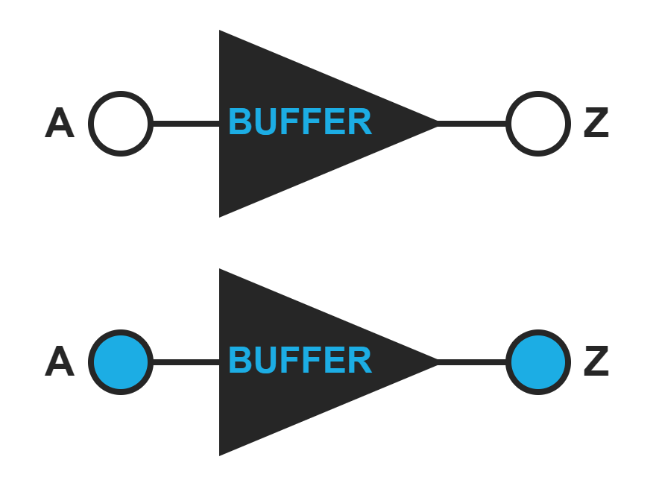
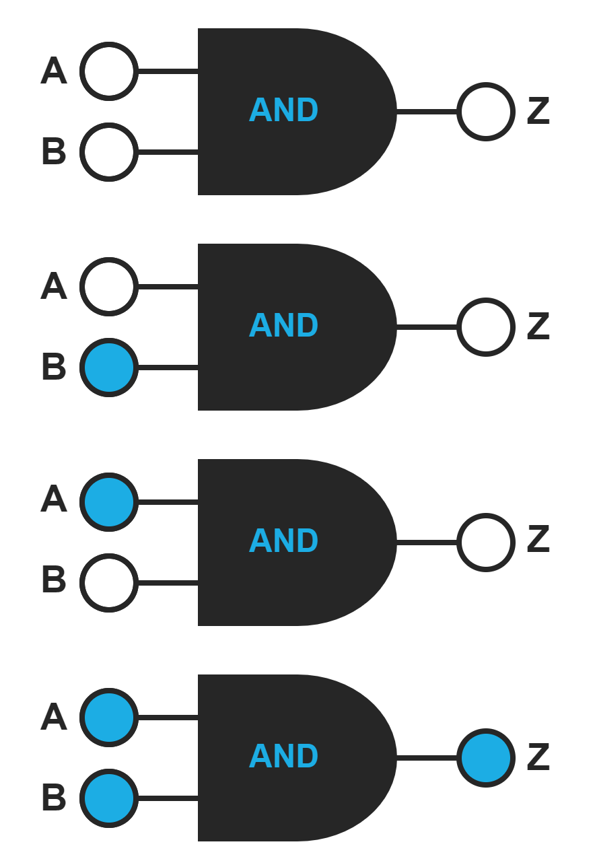
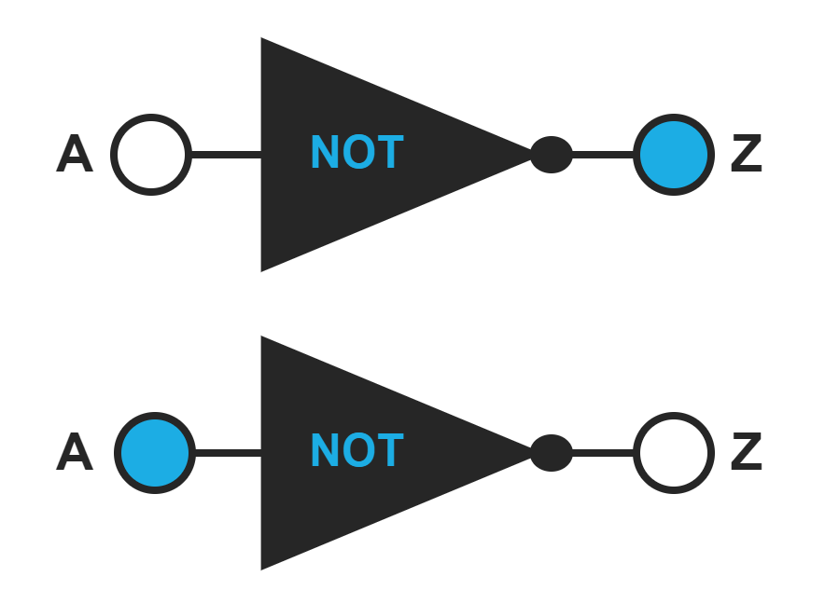
3
Logic and Circuits
A
Z
0
0
A
B
Z
1
1
0
0
0
0
1
0
A
Z
1
0
0
0
1
1
1
1
1
0

Slide 9
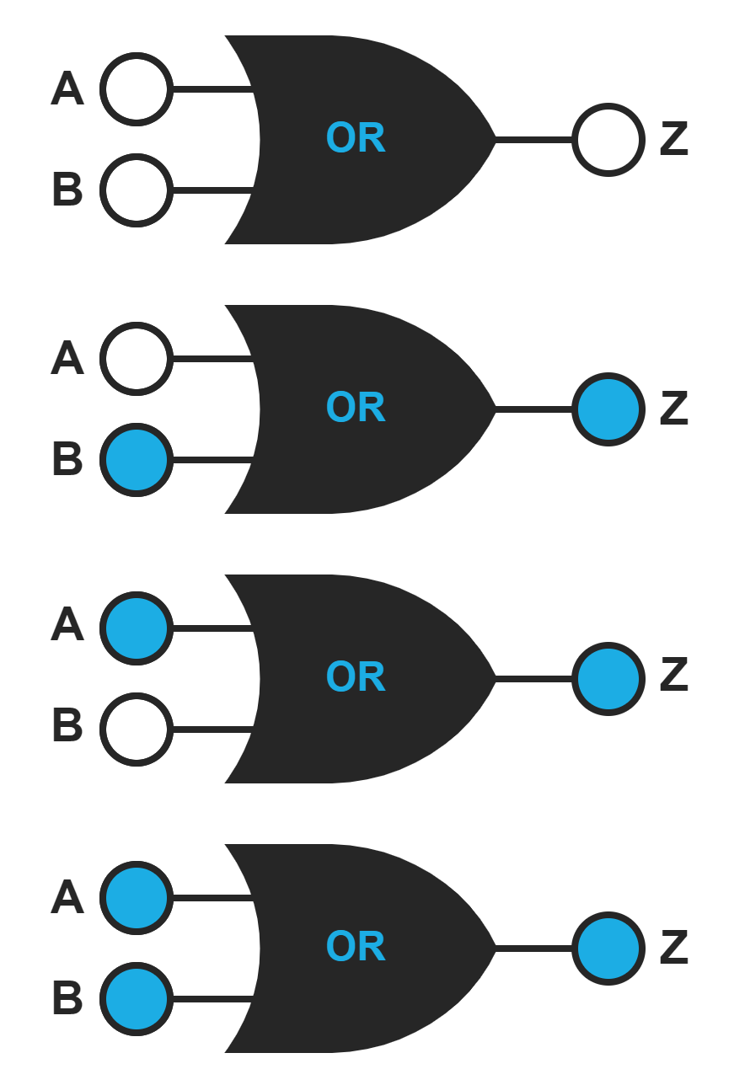
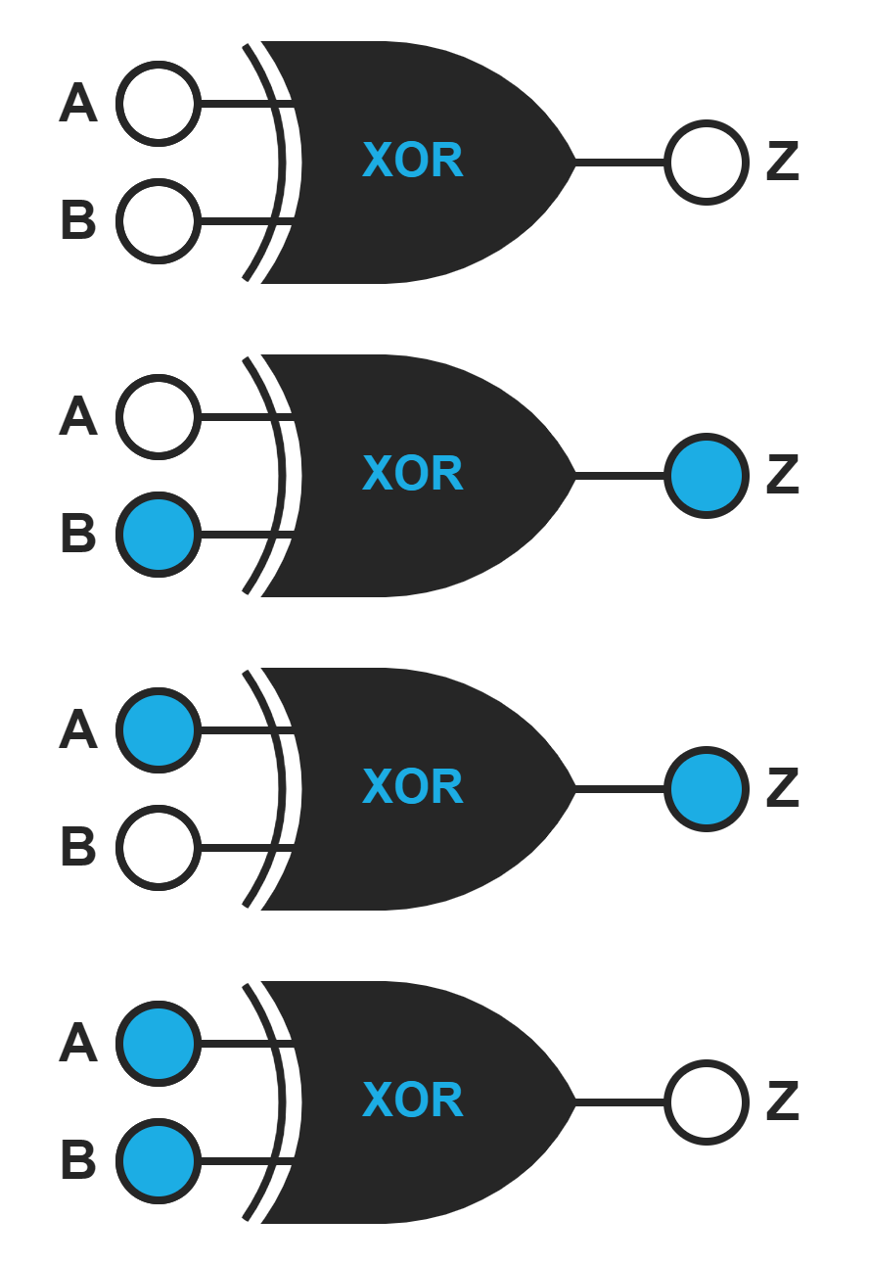
3
Logic and Circuits
A
B
Z
A
B
Z
0
0
0
0
0
0
0
1
1
0
1
1
1
0
1
1
0
1
1
1
1
1
1
0

Slide 10
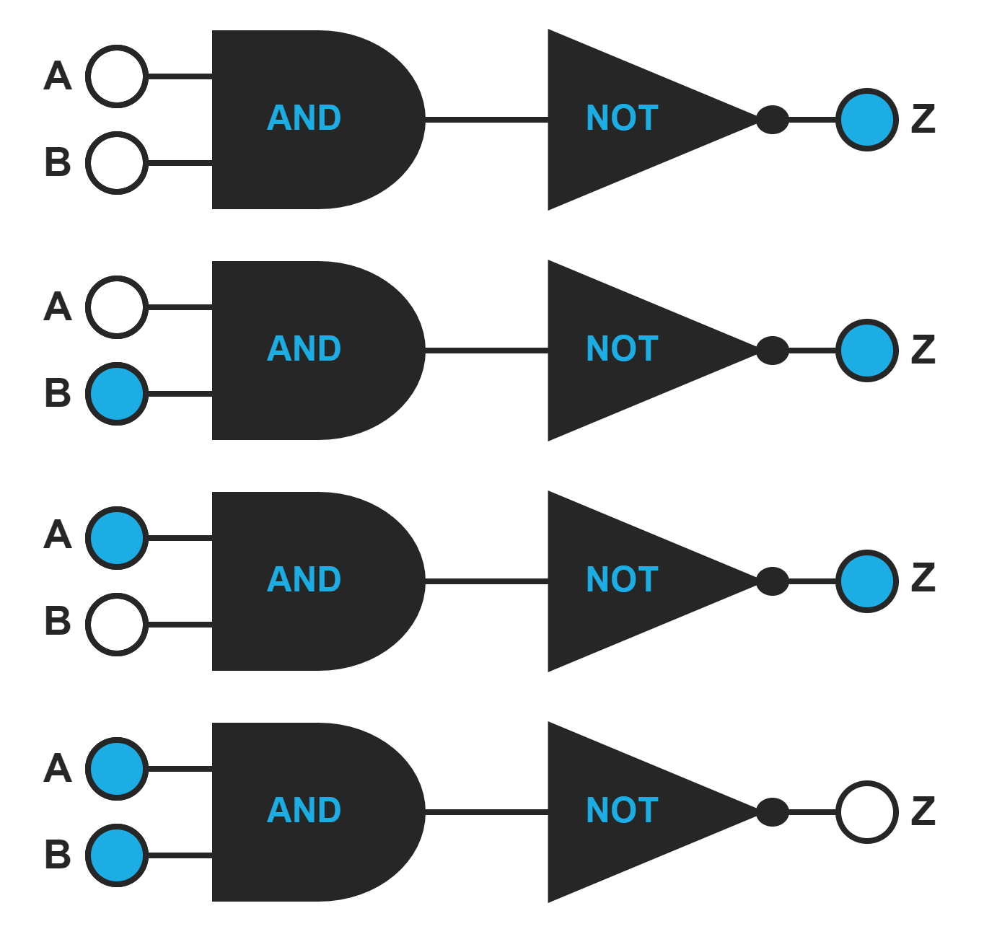
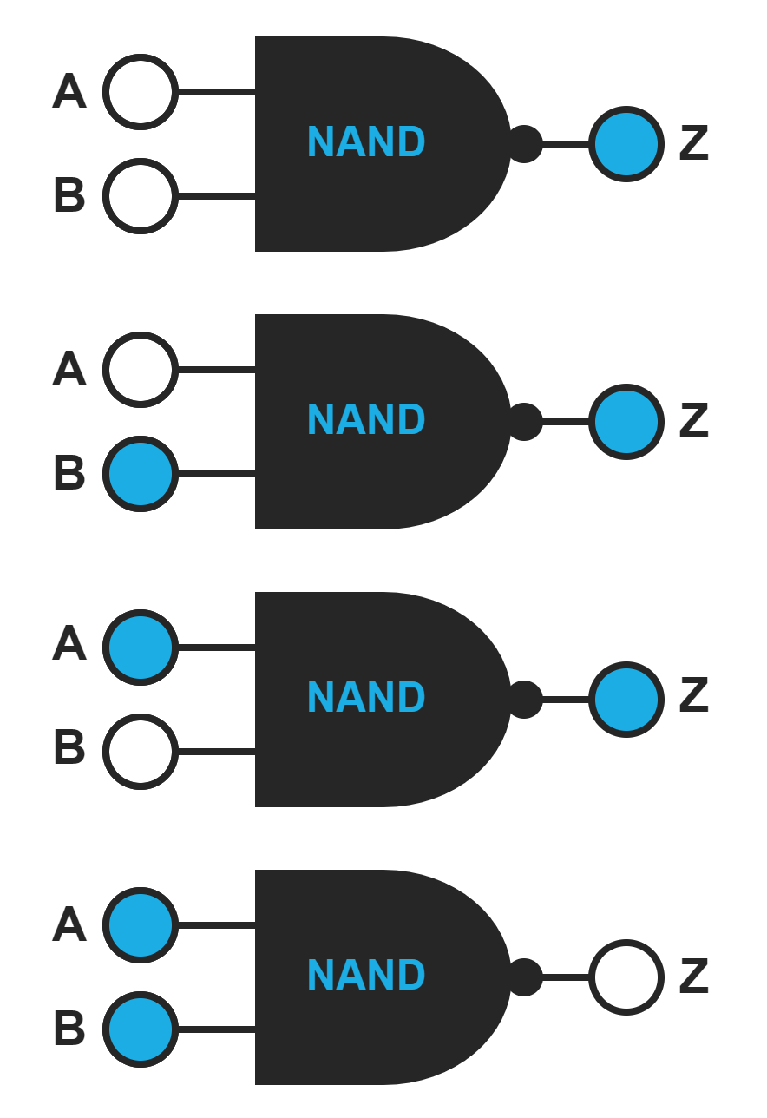
3
Logic and Circuits
A
B
Z
Z’
0
0
1
0
0
1
1
0
1
0
1
0
1
1
0
1

Slide 11
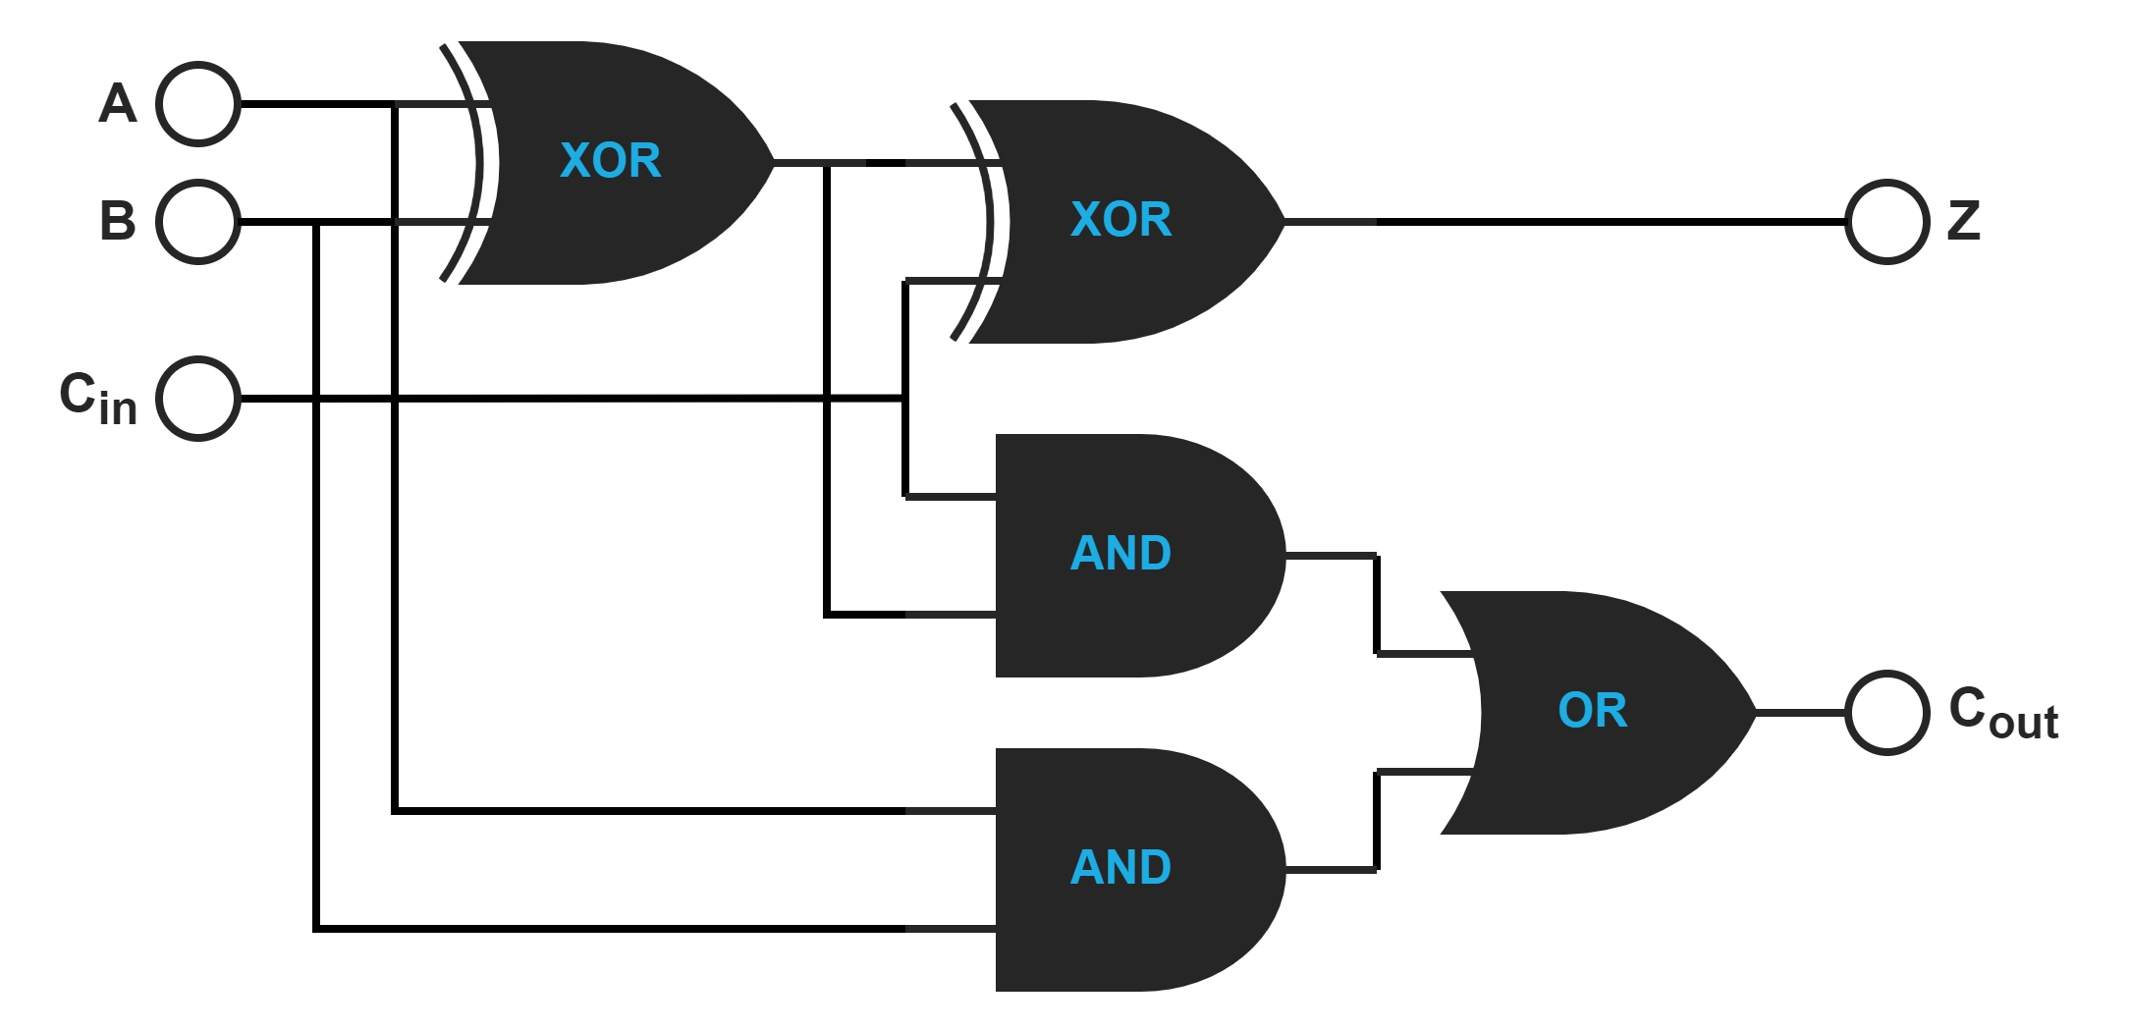
3
Logic and Circuits
A
B
Cin
Cout
Z
0
0
0
0
0
0
0
1
0
1
0
1
0
0
1
0
1
1
1
0
1
0
0
0
1
1
0
1
1
0
1
1
0
1
0
2-Bit Full Adder
1
1
1
1
1

Slide 12
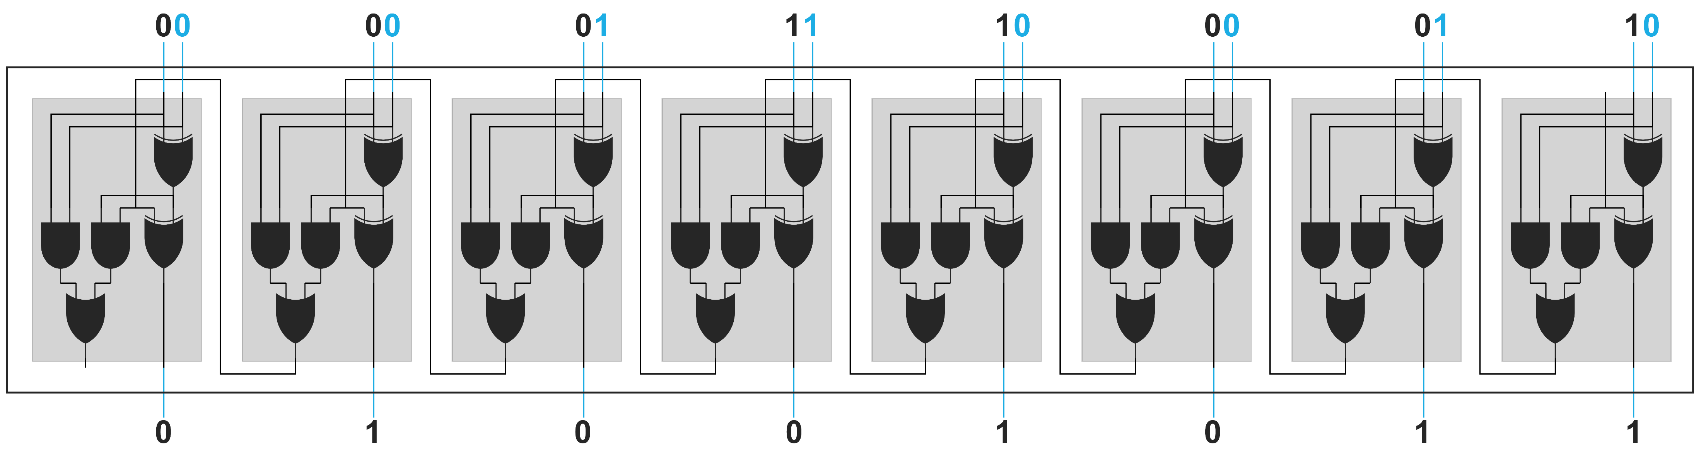
3
Logic and Circuits
8-Bit Full Adder
25 + 50 = 75
00011001
+ 00110010
01001011
00011001 + 00110010 = 01001011

Slide 13
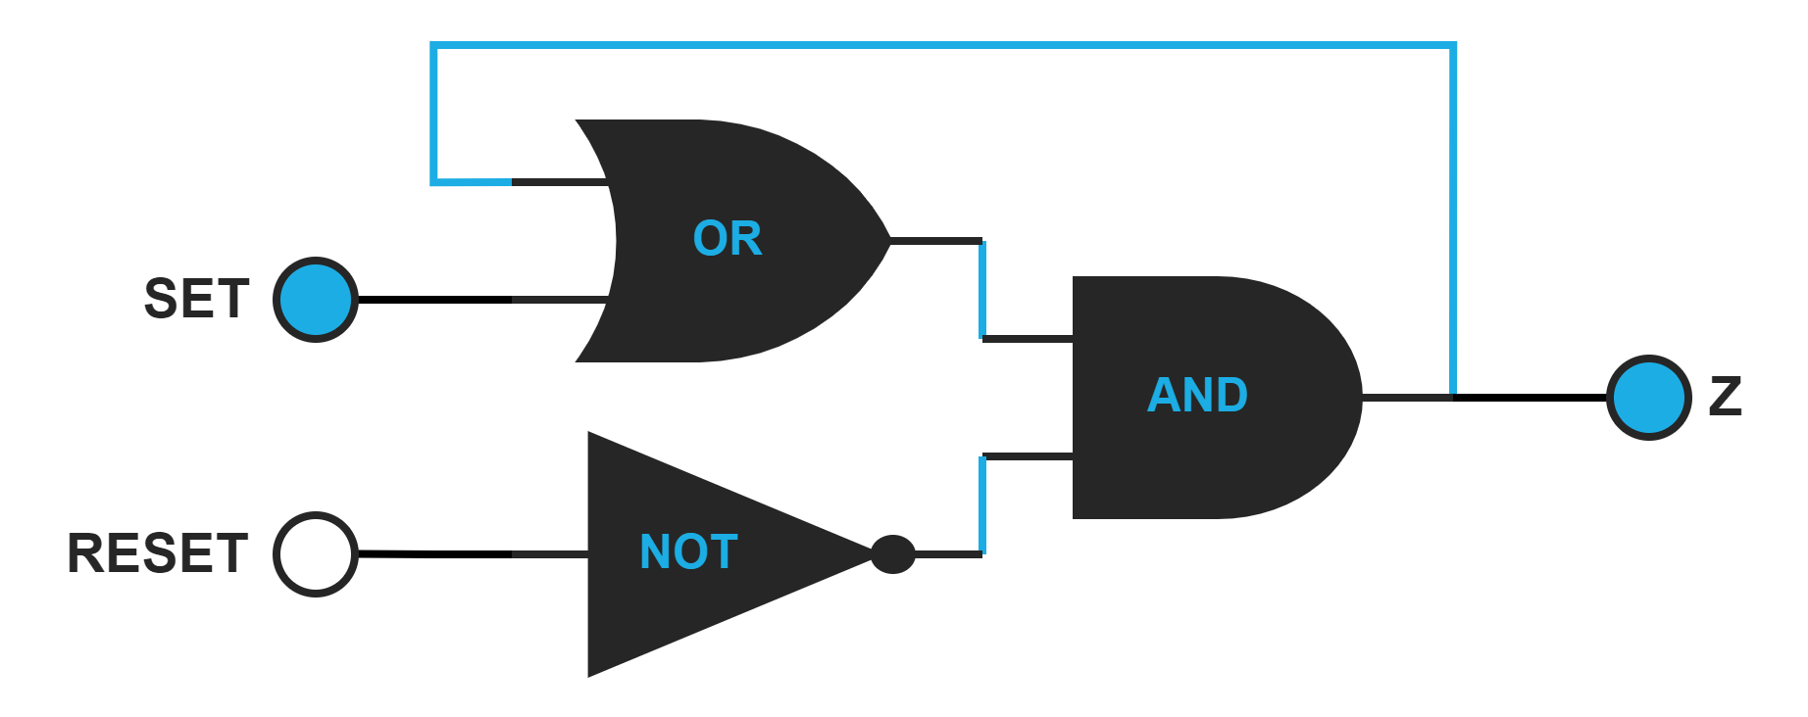
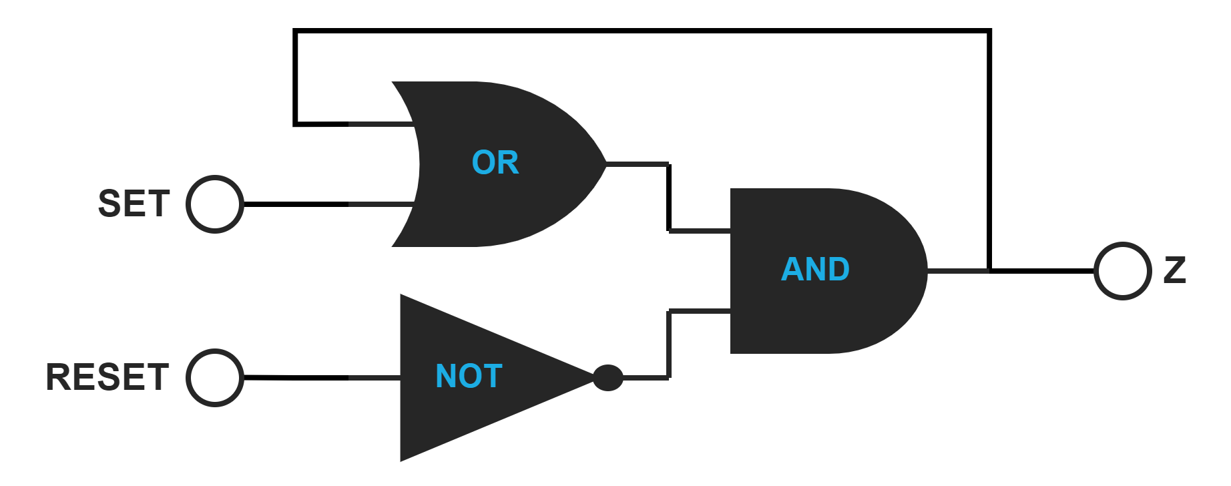
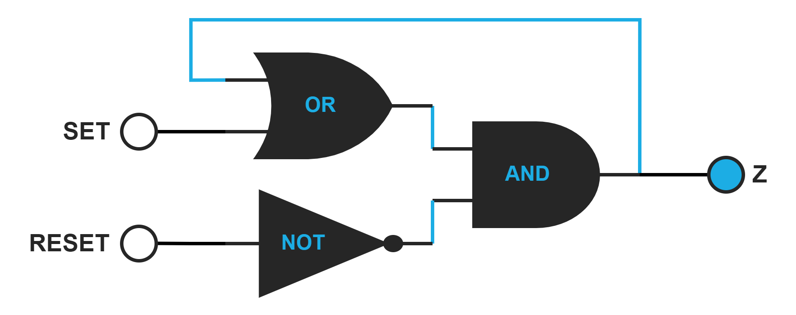
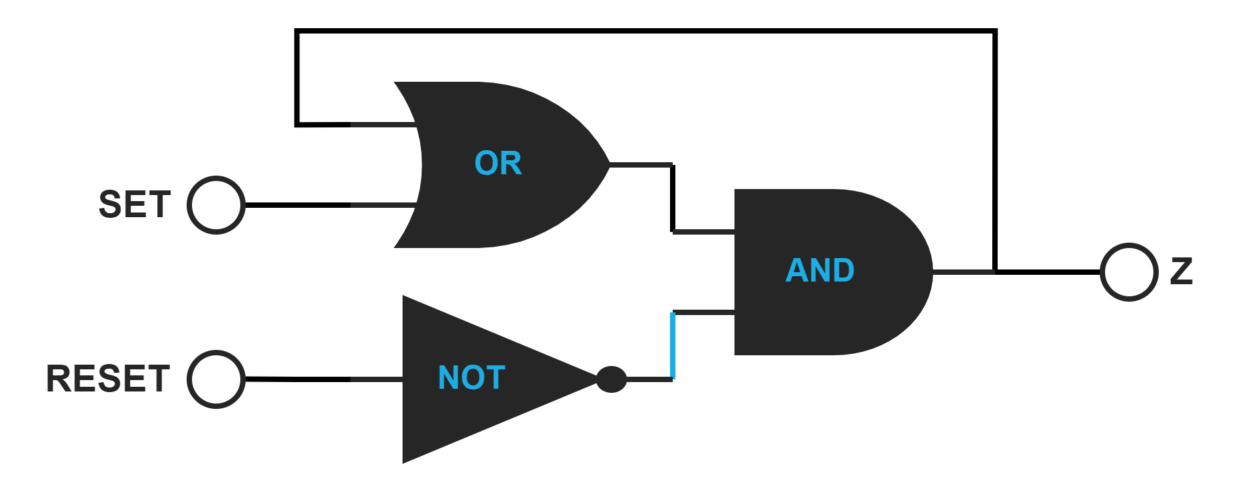
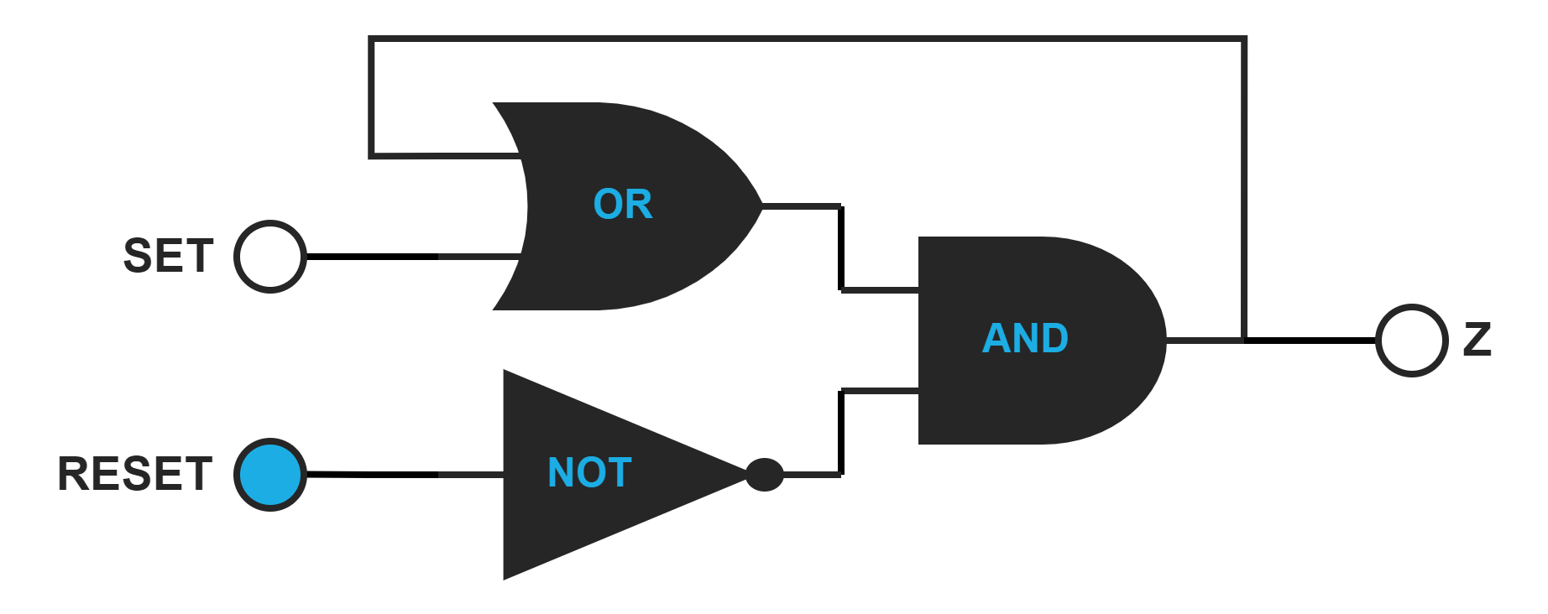
3
Logic and Circuits
Set-Reset Latch

Slide 14
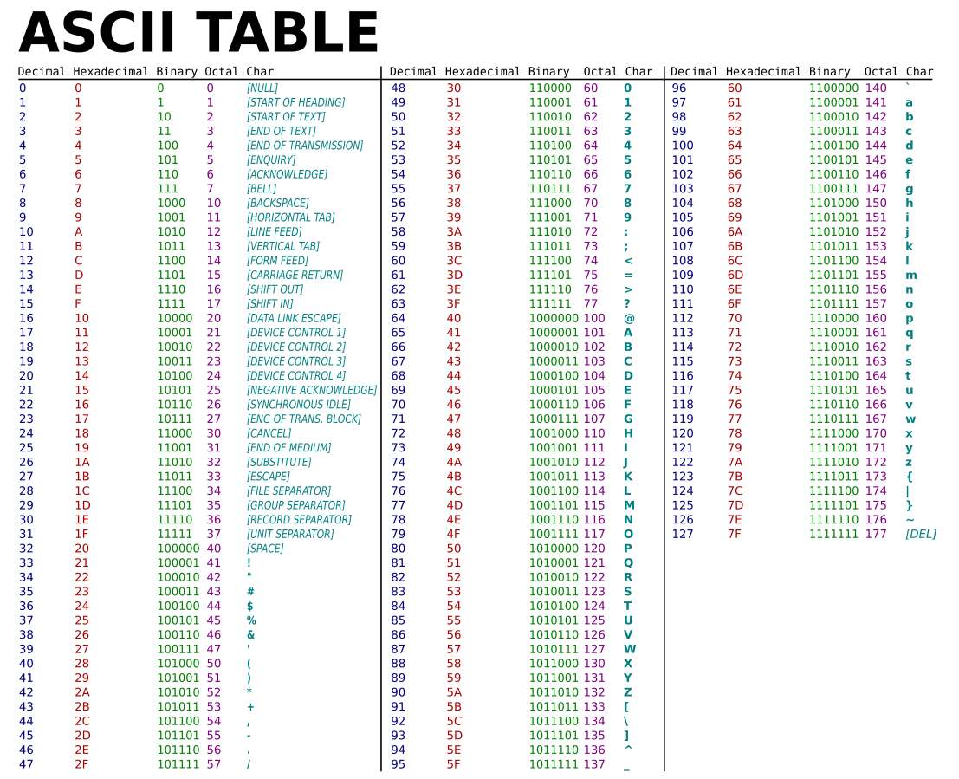

4
Displaying
M=01001101

Slide 15
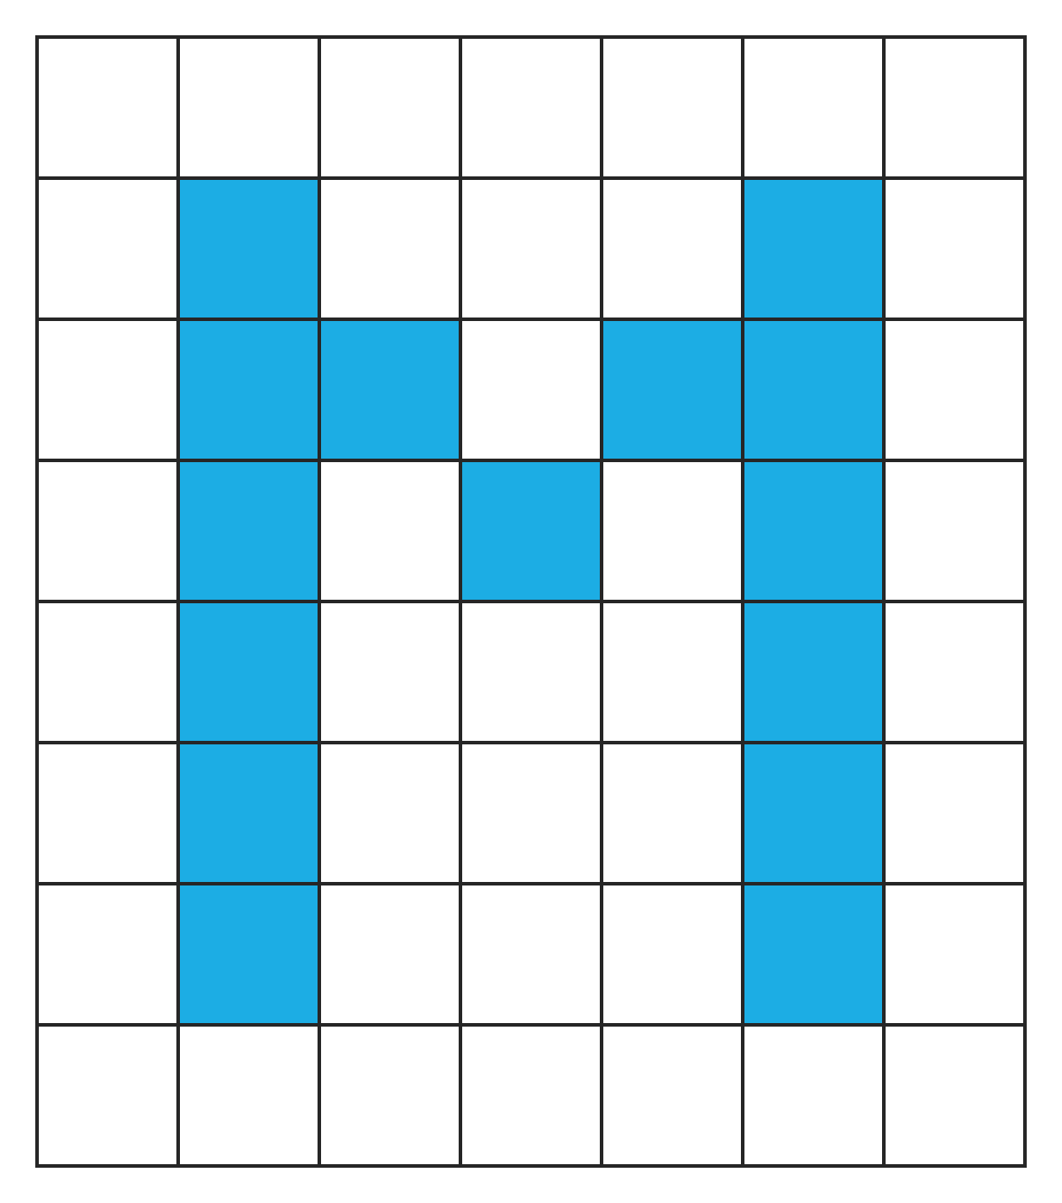
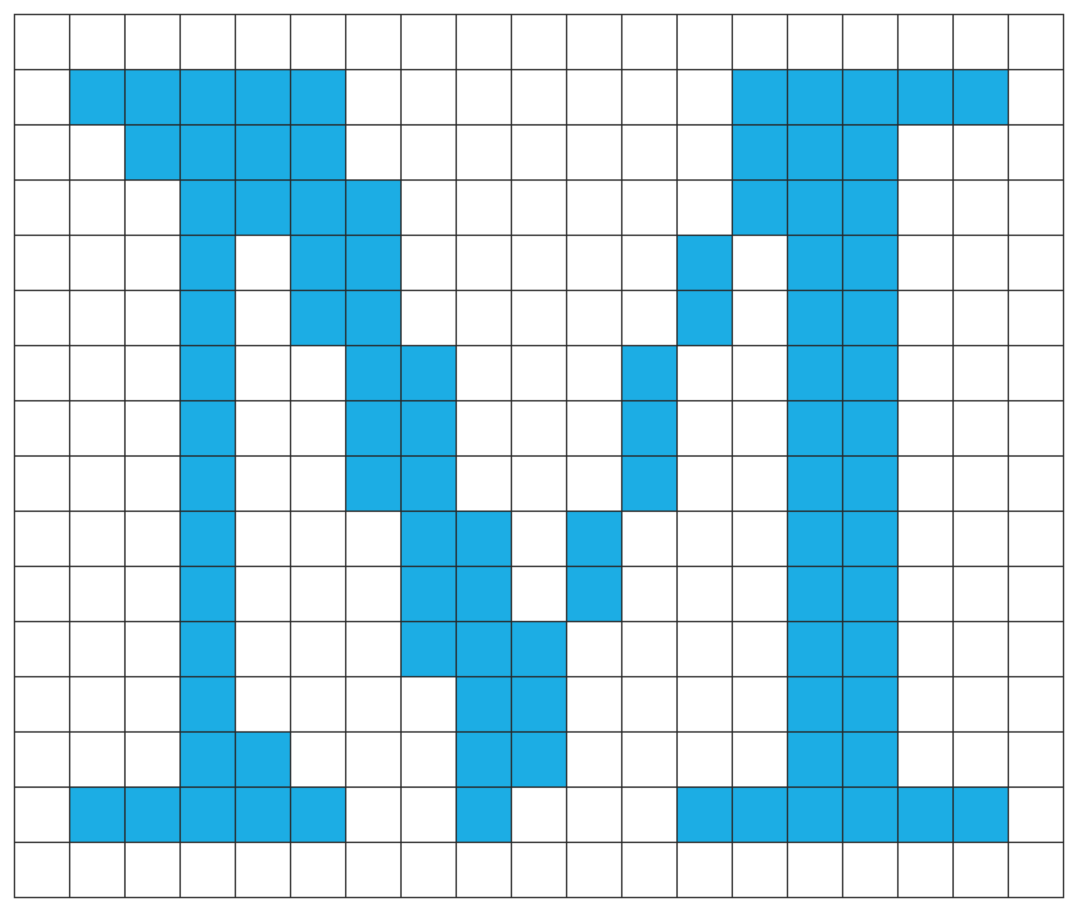
4
Displaying
M=01001101
=1
=0

Slide 16
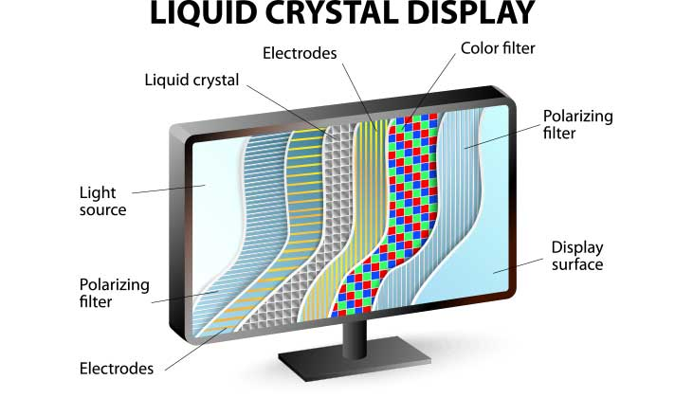
4
Displaying
=1
=0

Slide 17
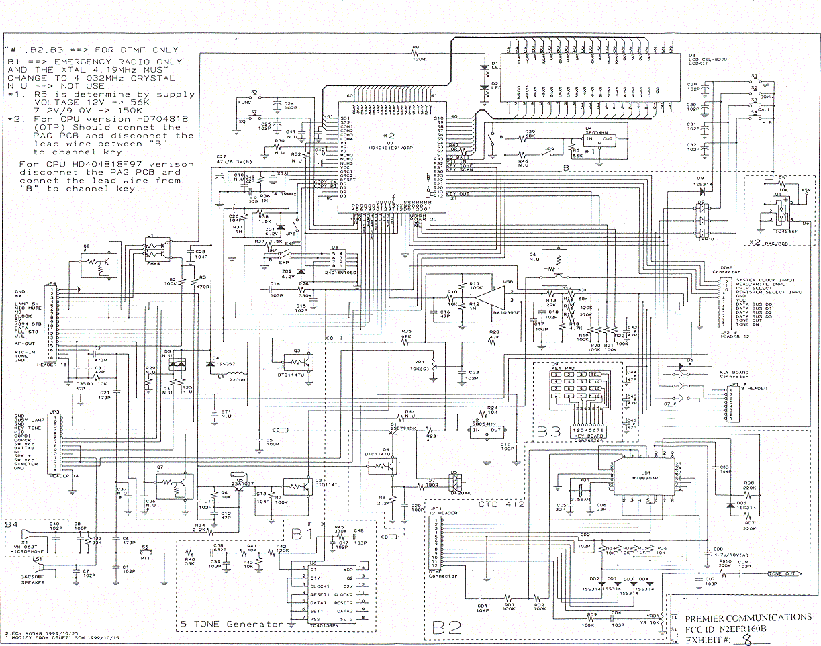

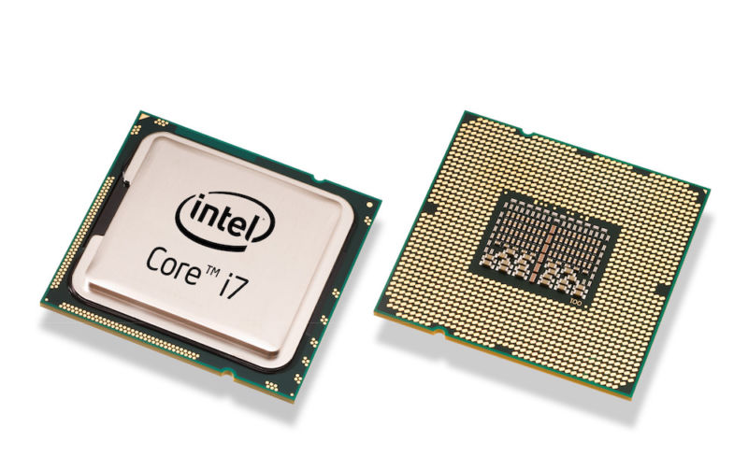
5
Programming
Central
Processing
Unit

Slide 18








5
Programming
Operating System
User
Application
Operating System
Hardware

Slide 19
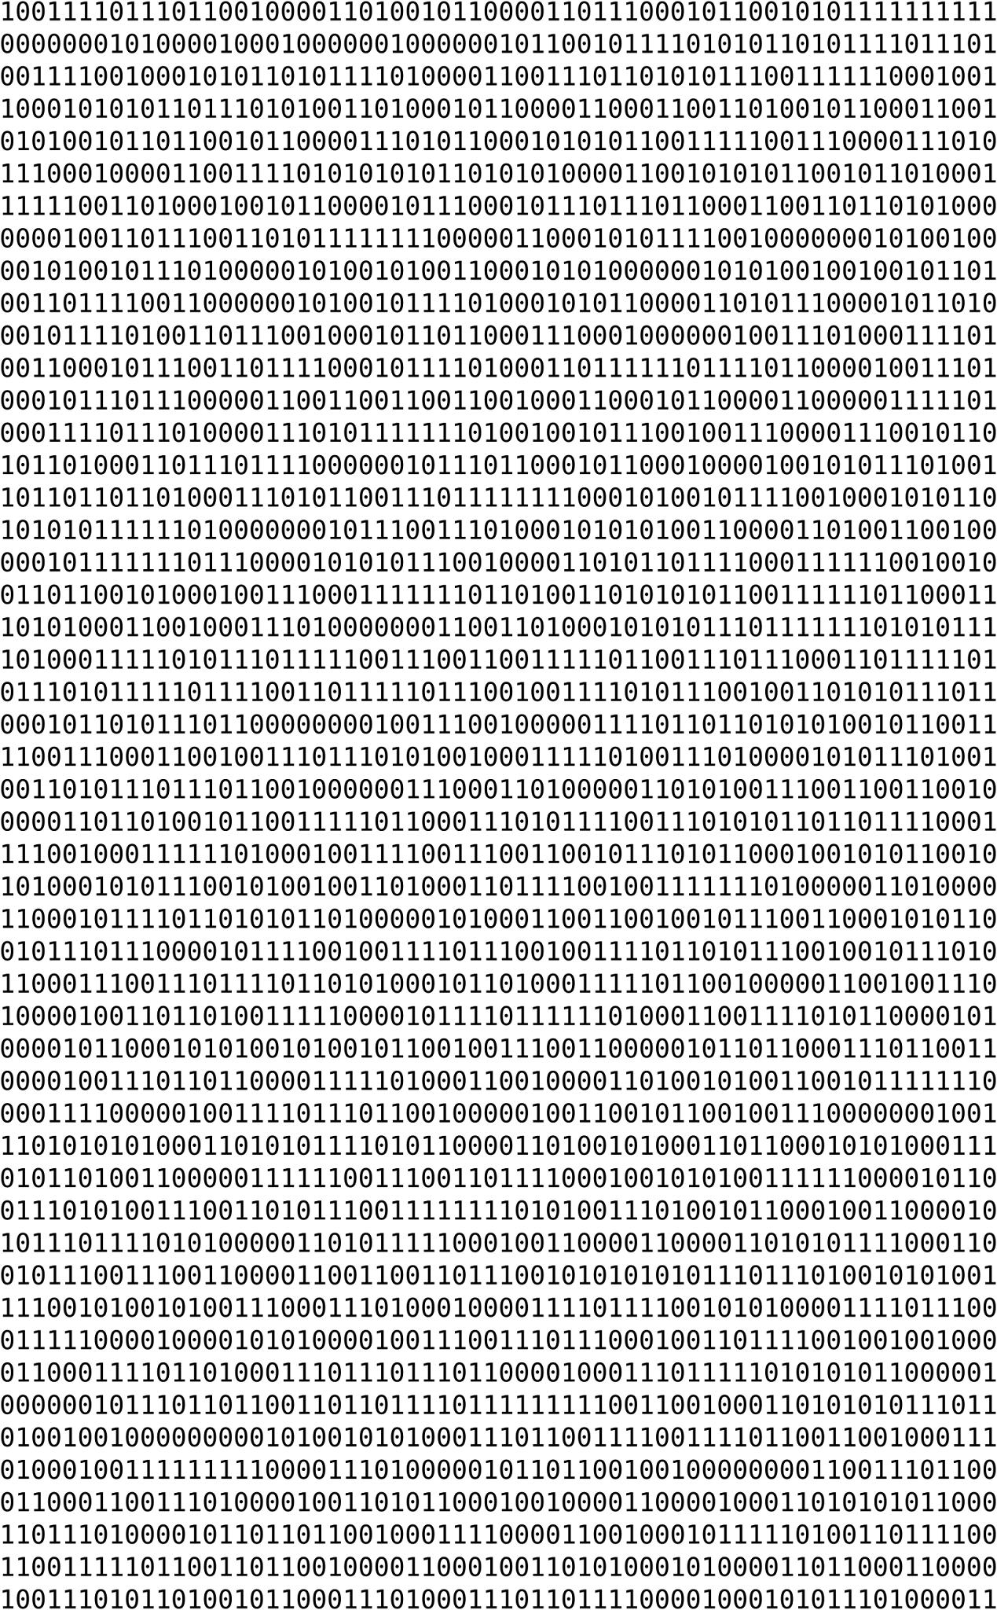
5
Programming
Nobody writes software in binary!
Programming Languages

Slide 20
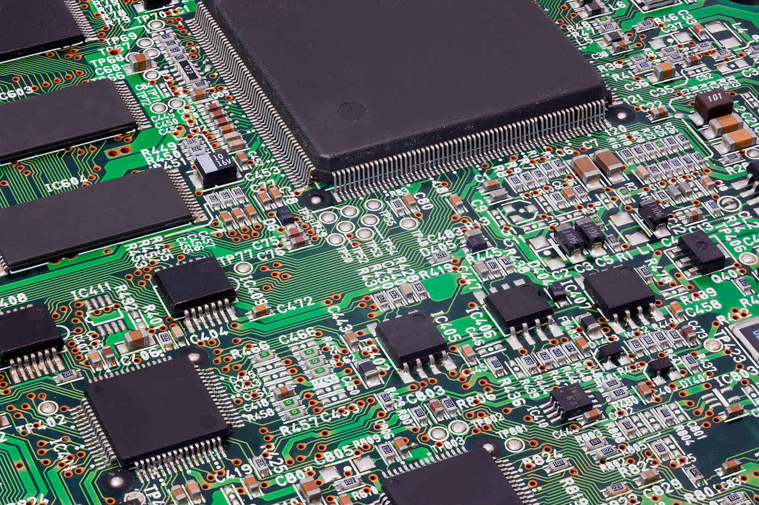
5
Programming
Interpreted Language
High Level Programing
High Level Language
Middle Level Language
Assembly Language
Low Level Programing
Machine Language
Hardware

Slide 21
5
Programming
Interpreted Language
0011 0000 0000 0000 ; load at x3000
X3000 0010 001 0 0000 0110 ; LD R1, x006
x3001 0110 010 001 000000 ; LDR R2, R1, #0
x3002 0000 010 0 0000 0101 ; BRz x005
;
; repeating statements go here
;
x3003 0001 001 001 1 00001 ; ADD R1, R1, #1
x3004 0000 111 0 0000 0001 ; BRnzp x001
x3005 1111 0000 0010 0101 ; HALT
;
; data section
;
x3006 0100 0000 0000 0000 ; x4000
High Level Programing
High Level Language
Middle Level Language
Assembly Language
Low Level Programing
Machine Language
Hardware

Slide 22
5
Programming
Interpreted Language
.top
; add num1 to num2
mov di,num1+digits-1
mov si,num2+digits-1
mov cx,digits ;
call AddNumbers ; num2 += num1
mov bp,num2 ;
call PrintLine ;
dec dword [term] ; decrement loop counter
jz .done ;
; add num2 to num1
mov di,num2+digits-1
mov si,num1+digits-1
mov cx,digits ;
call AddNumbers ; num1 += num2
High Level Programing
High Level Language
Middle Level Language
Assembly Language
Low Level Programing
Machine Language
Hardware

Slide 23
5
Programming
Interpreted Language
#include <stdio.h>
int main()
{
double firstNumber, secondNumber, product;
printf("Enter two numbers: ");
// Stores two floating point numbers in variable firstNumber and secondNumber respectively
scanf("%lf %lf", &firstNumber, &secondNumber);
// Performs multiplication and stores the result in variable productOfTwoNumbers
product = firstNumber * secondNumber;
// Result up to 2 decimal point is displayed using %.2lf
printf("Product = %.2lf", product);
return 0;
}
High Level Programing
High Level Language
Middle Level Language
Assembly Language
Low Level Programing
Machine Language
Hardware

Slide 24
5
Programming
Interpreted Language
public class Fibonacci {
public static void main(String[] args) {
int n = 10, t1 = 0, t2 = 1;
System.out.print("First " + n + " terms: ");
for (int i = 1; i <= n; ++i)
{
System.out.print(t1 + " + ");
int sum = t1 + t2;
t1 = t2;
t2 = sum;
}
}
}
High Level Programing
High Level Language
Middle Level Language
Assembly Language
Low Level Programing
Machine Language
Hardware

Slide 25
5
Programming
Interpreted Language
def bubbleSort(arr):
n = len(arr)
# Traverse through all array elements
for i in range(n):
# Last i elements are already in place
for j in range(0, n-i-1):
# traverse the array from 0 to n-i-1
# Swap if the element found is greater
# than the next element
if arr[j] > arr[j+1] :
arr[j], arr[j+1] = arr[j+1], arr[j]
High Level Programing
High Level Language
Middle Level Language
Assembly Language
Low Level Programing
Machine Language
Hardware

Slide 26
5
Programming
Interpreted Language
High
Low
High
High Level Programing
High Level Language
Middle Level Language
Human Readability
Execution Speed
Language Level
Assembly Language
Low Level Programing
Machine Language
Hardware
Low
High
Low

Slide 27



6
Translators
Interpreter
Object file
cpython
Source
Executable file
.py
.exe
Compiler
Object file
.o

Slide 28
6
Translators
Machine Independent Code Optimizer
Semantic Analyzer
Code Generator
Syntax Analyzer
Abstract Syntax Tree
Assembly
Intermediate Code Generator
Machine Dependent Code Optimizer
Lexical Analyzer
Parse Tree
Compiler
Object file
.o
Symbol Table
Error Handler

Slide 29
6
Translators
Interpreter
Object file
cpython
Source
Libraries
Linker
Executable file
.py
.exe
Compiler
Object file
.o

Slide 30










7
IDE and Editors
IDE
(Integrated Development Environment)
Code Editor

